Slide 1
Basic Parametric Statistics Solutions 1-2
Ruth Nysen, PhD & Jeroen Wynen, PhD
Cristina Cametti

Slide 2
Question a
From descriptive statistics to hypothesis testing
Men and women seem well balanced
 | Frequency | Percent
Females | 31 | 41,33
Males | 44 | 58,67

Slide 3
Question b: Systolic
From descriptive statistics to hypothesis testing
 | Frequency | Percent | Cumulative freq | Cumulative percent
0 | 1 | 1,33 | 1 | 1,33
1 | 0 | 0,00 | 1 | 1,33
2 | 1 | 1,33 | 2 | 2,67
3 | 8 | 10,67 | 10 | 13,33
4 | 17 | 22,67 | 27 | 36,00
5 | 14 | 18,67 | 41 | 54,67
6 | 10 | 13,33 | 51 | 68,00
7 | 9 | 12,00 | 60 | 80,00
8 | 7 | 9,33 | 67 | 89,33
9 | 8 | 10,67 | 75 | 100,00
54% have risk group up to 5
Mode: group 4, more or less symmetric around 4

Slide 4
Question b: Diastolic
From descriptive statistics to hypothesis testing
 | Frequency | Percent | Cumulative freq | Cumulative percent
0 | 5 | 6,67 | 5 | 6,67
1 | 7 | 9,33 | 12 | 16,00
2 | 12 | 16,00 | 24 | 32,00
3 | 10 | 13,33 | 34 | 45,33
4 | 9 | 12,00 | 43 | 57,33
5 | 12 | 16,00 | 55 | 73,33
6 | 10 | 13,33 | 65 | 56,67
7 | 5 | 6,67 | 70 | 93,33
8 | 5 | 6,67 | 75 | 100,00
9 | 0 | 0,00 | 75 | 100,00
Less clear mode: risk groups 2-6 more or less equal

Slide 5
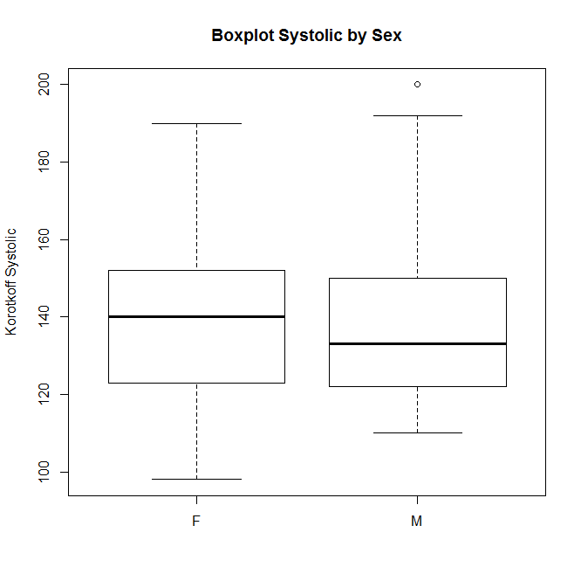
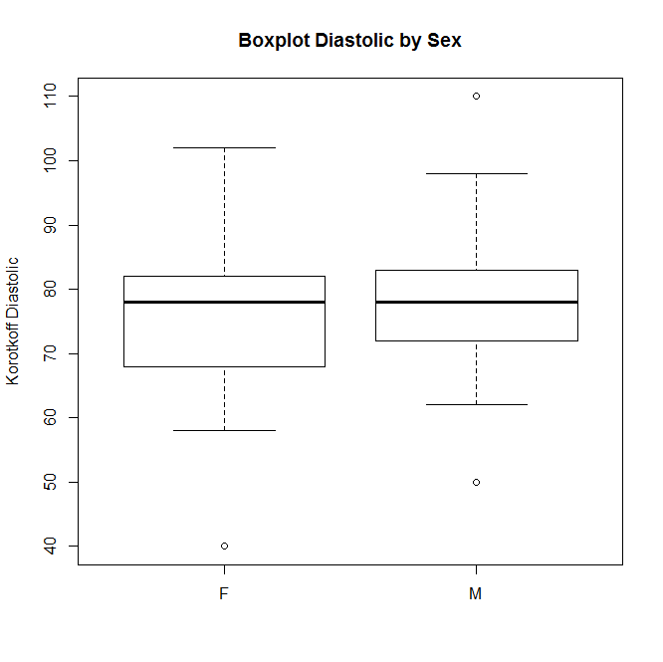
Question c
From descriptive statistics to hypothesis testing
Slightly skewed to the right in both cases
There do not seem to be differences between males and females

Slide 6
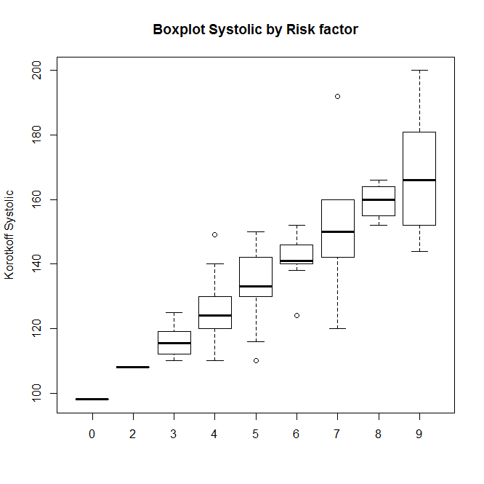
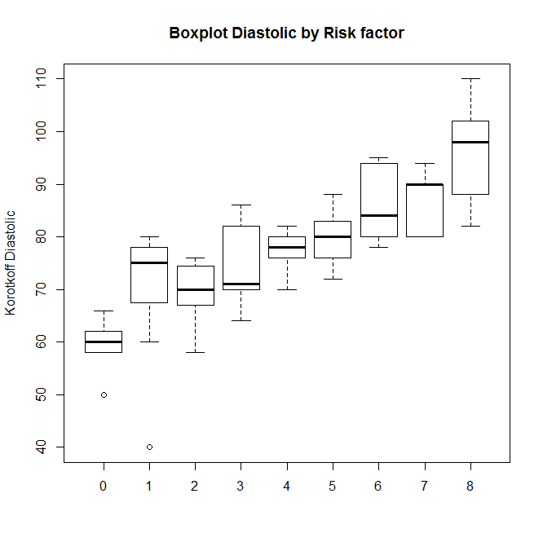
Question d
From descriptive statistics to hypothesis testing
Upward trend as a function of risk group
Differences in variability
If no overlap between boxes: suggest difference

Slide 7
Question e: descriptive statistics
From descriptive statistics to hypothesis testing
Systolic | Male | Female
Sample size | 44 | 31
Mean | 137,75 | 138,77
Std. Dev. | 20,783 | 19,913
Diastolic | Male | Female
Sample size | 44 | 31
Mean | 78,55 | 75,29
Std. Dev. | 10,560 | 12,461

Slide 8
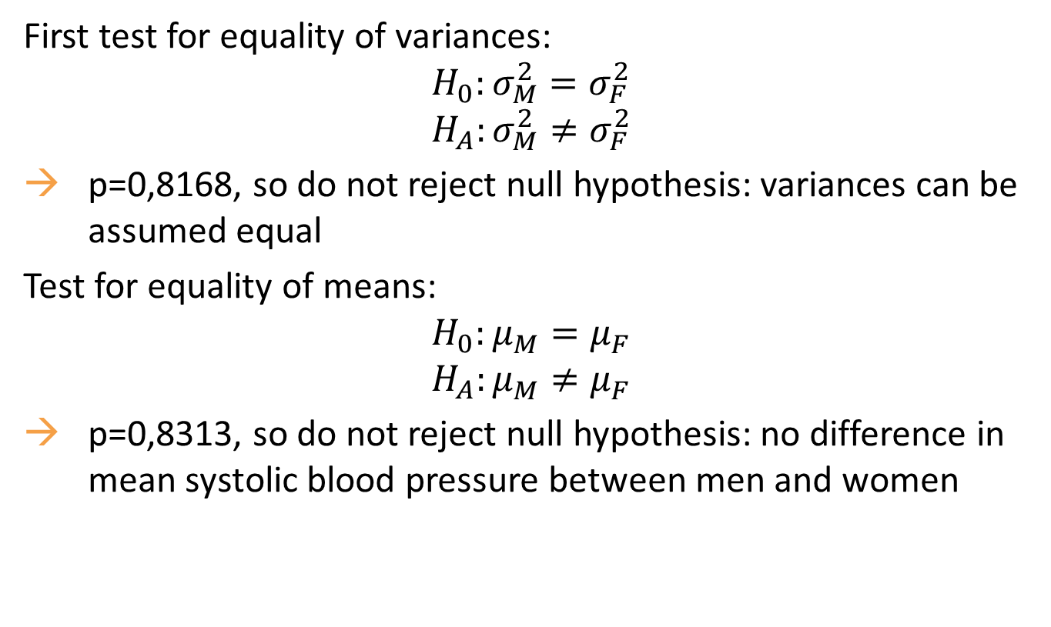
Question e: systolic blood pressure
From descriptive statistics to hypothesis testing
First test for equality of variances:
$$H_{0}:σ_{M}^{2}=σ_{F}^{2}$$
$$H_{A}:σ_{M}^{2}≠σ_{F}^{2}$$
p=0,8168, so do not reject null hypothesis: variances can be assumed equal
Test for equality of means:
$$H_{0}:μ_{M}^{}=μ_{F}^{}$$
$$H_{A}:μ_{M}^{}≠μ_{F}^{}$$
p=0,8313, so do not reject null hypothesis: no difference in mean systolic blood pressure between men and women

Slide 9
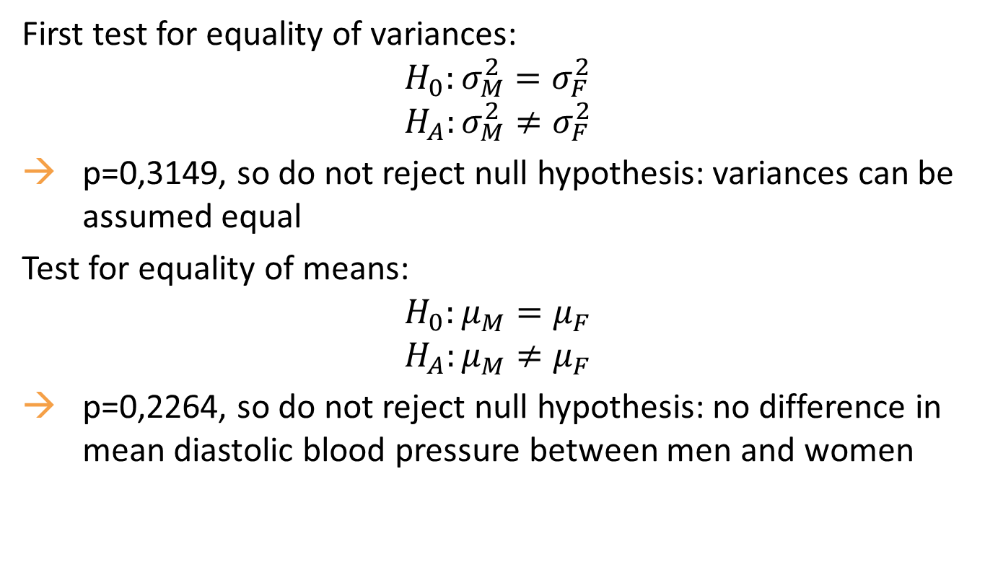
Question e: diastolic blood pressure
From descriptive statistics to hypothesis testing
First test for equality of variances:
$$H_{0}:σ_{M}^{2}=σ_{F}^{2}$$
$$H_{A}:σ_{M}^{2}≠σ_{F}^{2}$$
p=0,3149, so do not reject null hypothesis: variances can be assumed equal
Test for equality of means:
$$H_{0}:μ_{M}^{}=μ_{F}^{}$$
$$H_{A}:μ_{M}^{}≠μ_{F}^{}$$
p=0,2264, so do not reject null hypothesis: no difference in mean diastolic blood pressure between men and women

Slide 10
Question f
From descriptive statistics to hypothesis testing
Systolic blood pressure:
Increasing trend for median BP
Taking into account BP: risk categories 3-4-5-6 might be different
IQR for category 7 and 9 is high, hard to discriminate between higher risk categories
Normal range: up to 75% percentile of category 6 around 150
Diastolic blood pressure:
We fail to see a relationship for median BP
IQR is high over categories, so differences are difficult to observe

Slide 11
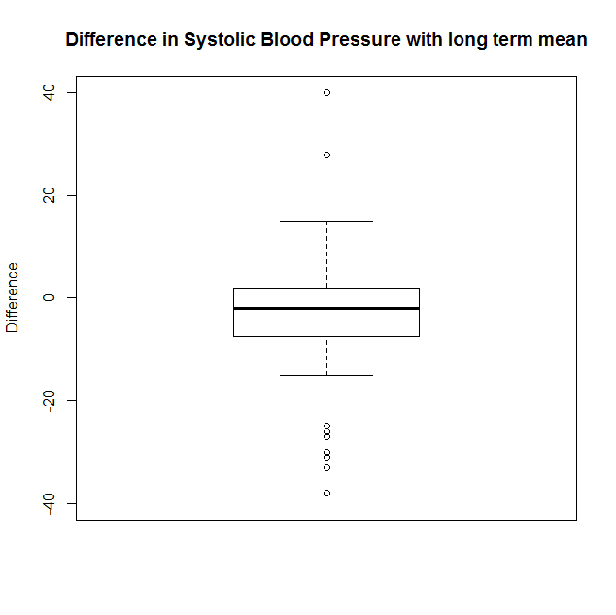
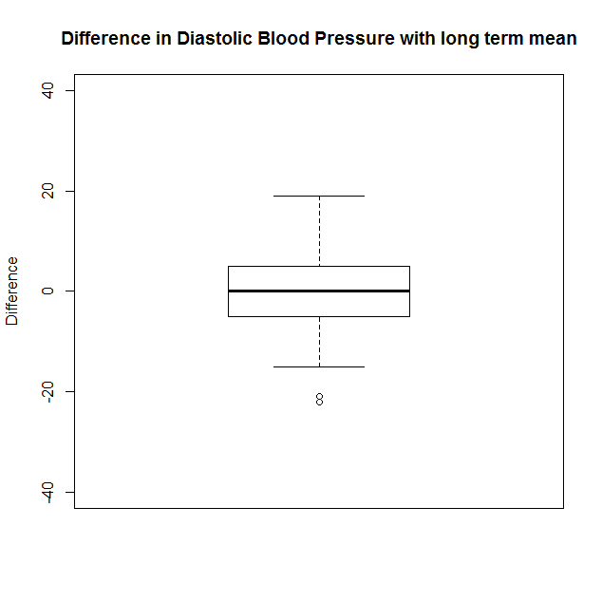
Question g
From descriptive statistics to hypothesis testing
Look at differences between long term mean blood pressure and blood pressure:

Slide 12
Question g
From descriptive statistics to hypothesis testing
Both boxes (from boxplot) contain 0 → there might be no difference.
We check with paired t-test:
Systolic blood pressure: p=0,02146, so difference is significant Be careful, since a lot of negative outliers!
Diastolic blood pressure: p=0,8397, so difference not significant
Remark: same conclusion based on confidence interval!

